Slide 1
Quantum Attacks Against Cryptography, Implications of Grover’s Algorithm
Amir Vince Zaman

Slide 2
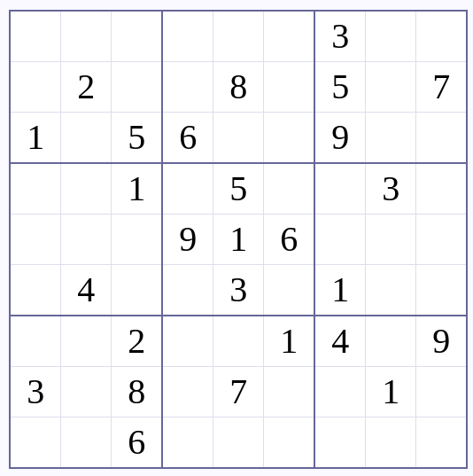
Notes:
“What kind of problem is this?”

Slide 3
WRONG!
Notes:
Lets do an exercise!!!
Solve this sudoku puzzle

Slide 4
Problem Set Up
Unstructured search
“Boolean Function”
True = found my item, False = that is not my item
NP problem where we can quickly verify if a solution is correct
O(N)
Quantum algorithm offers quadratic speedup O(sqrt(N))
Notes:
Tricked them from previous slide!!
Np problem
Quickly verify the corectness, cannot quickly come to the solution iteself

Slide 5
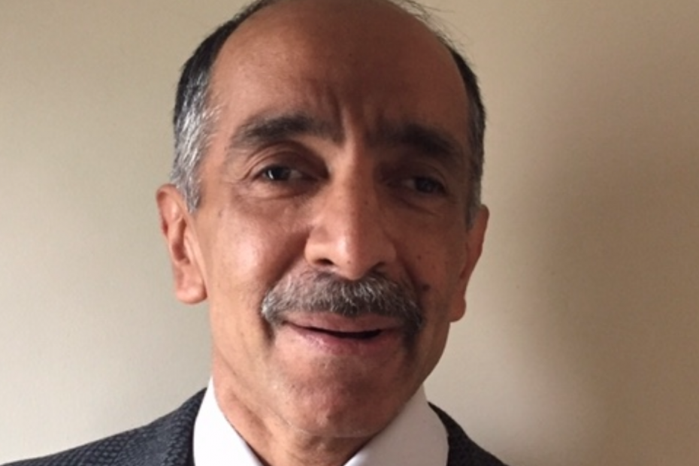
Grover’s Algorithm Background/High Level
Quadratic speedup to unstructured searching
Base form of attack to beat
Lov Kumar Grover
ref: IIT Delhi alumni website
Notes:
“Base form of attack to beat”
If Shor’s didn’t exist you can still guess and check
Lov Kumar Grover

Slide 6
Grover: Circuit Set Up
Oracle (verifier)
Boolean function
Each basis state represents a candidate solution
Output: phase flips only the valid solution amplitude
Creates a real but unmeasurable difference, obscured by superposition probabilities
Oracle must change depending on what solution is verified
Ex. different starts of sudoku, different cipher/plaintext pairs
Diffusion Operator
H (2 |0⟩ ⟨0| - I) H
Boosts the candidate solution by inverting around the mean of the amplitudes
H’s turn the |0⟩ ⟨0| into uniform distribution
One sequence of applying these is “G”, one grover iteration
Notes:
Basis states are all possible candidates 2^n n=#ofqubits
Grover called it Diffusion because how the matrices involved resemble some diffusion principles in mathemeatic (that I am unaware of)
“REAL BUT UNMEASUREABLE DIFFERENCE obscured by the nature of superpositions” -> quantum mechanics is funky like that
Very good vid on grovers from IBM:
https://www.youtube.com/watch?v=hnpjC8WQVrQ

Slide 7
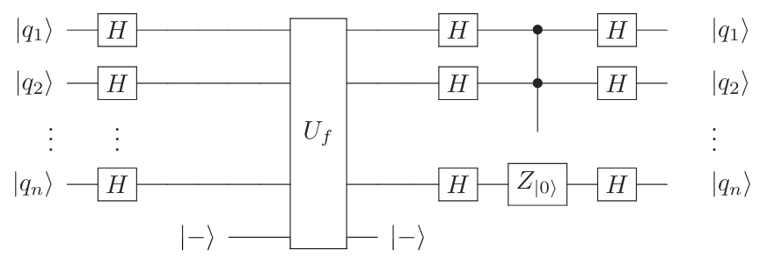
Grover Circuit
Diffusion
initialization
Oracle
G

Slide 8
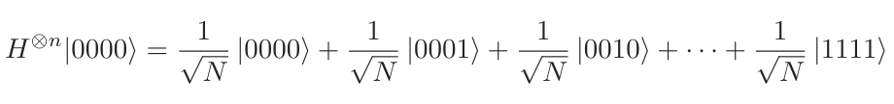
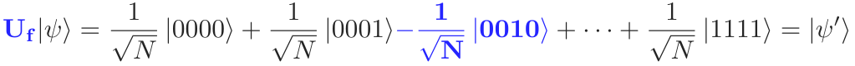
initialization

Slide 9
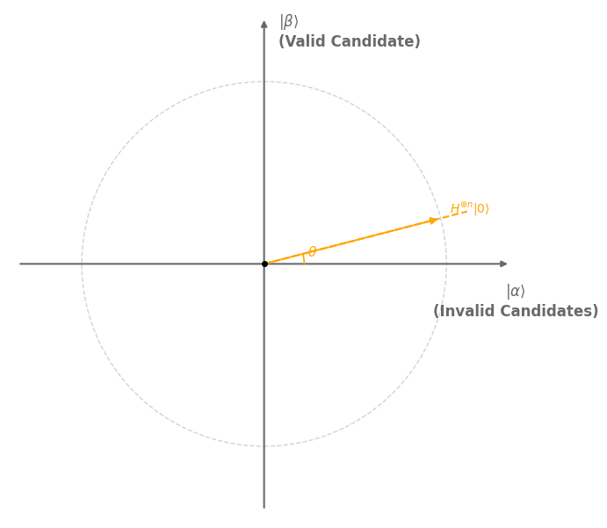
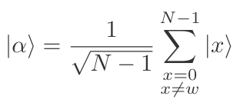

Grover: Mapping to the Solution Space
Vector state at any given time is linear combo of:
| 𝜶 ⟩ : uniform superposition of all possible non-solutions
| 𝜷 ⟩ : uniform superposition of all possible solutions (usually 1)
This spans a 2d space
Notes:
x is all vector states that are invalid solutions
w is the one vector state that is valid

Slide 10
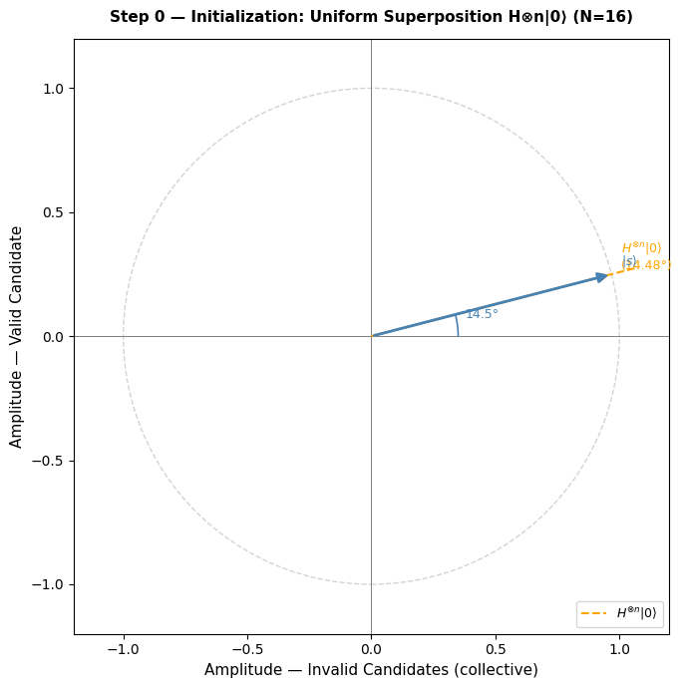
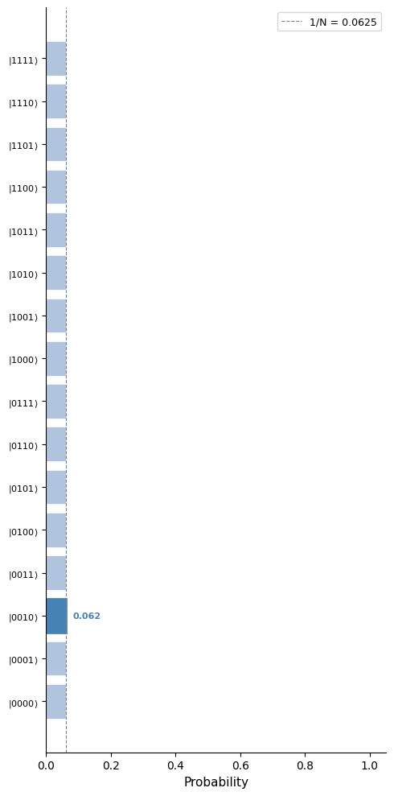

Slide 11
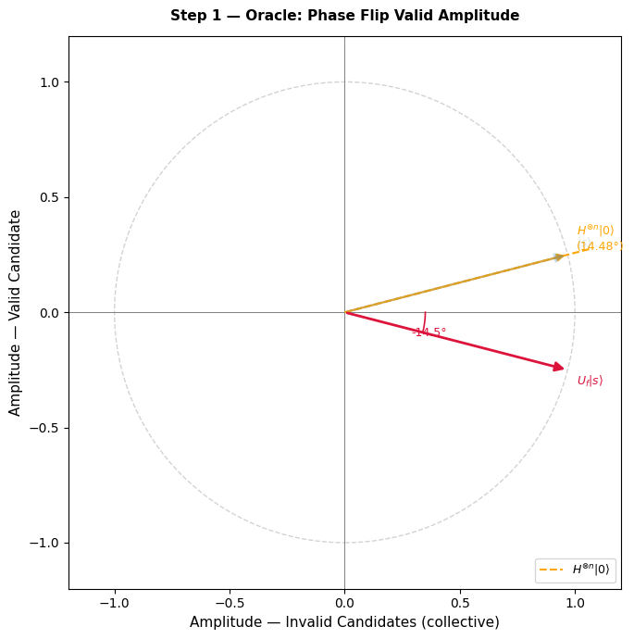
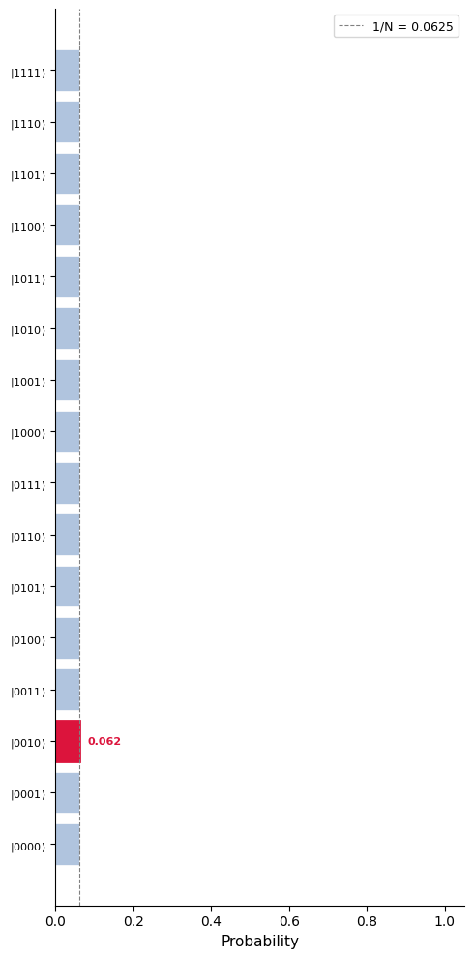

Slide 12
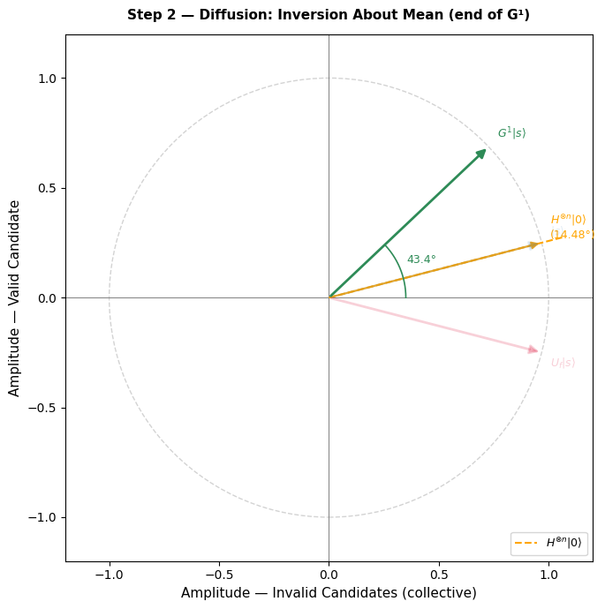
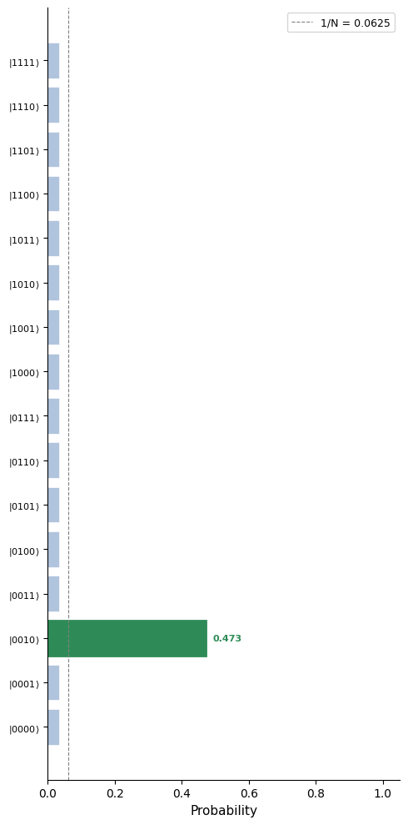

Slide 13
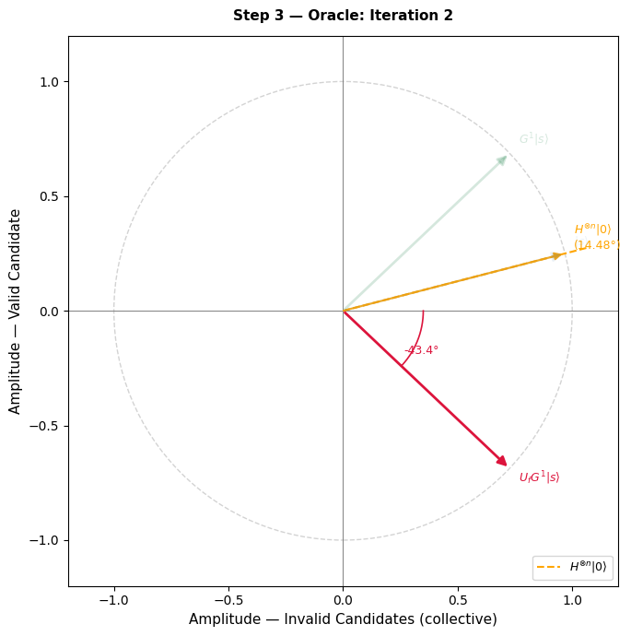
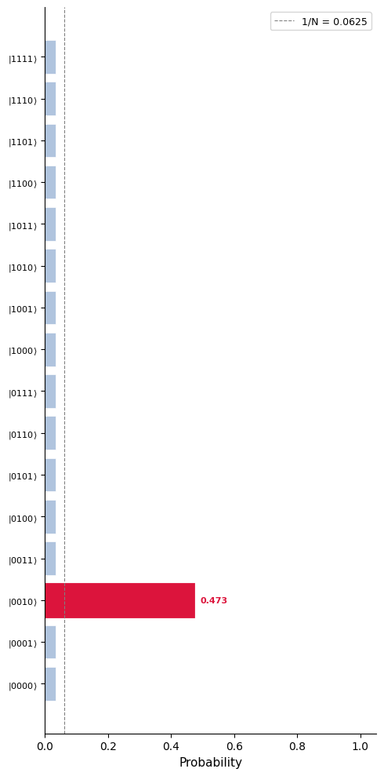

Slide 14
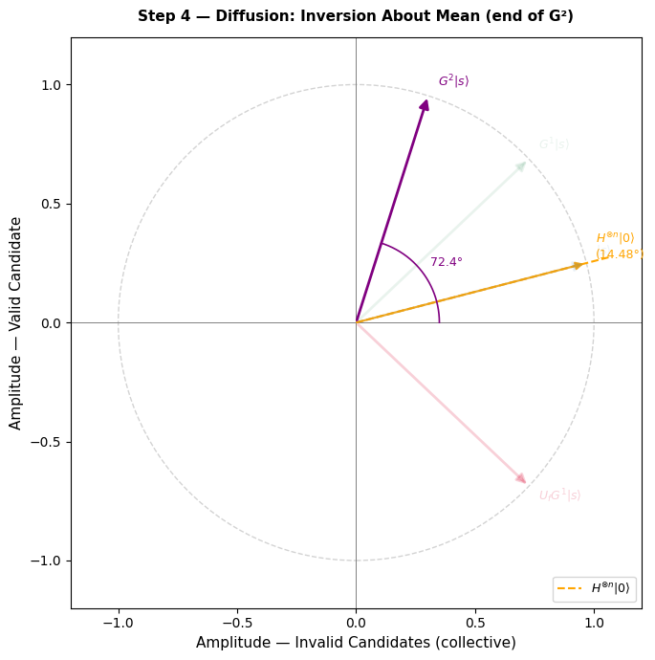
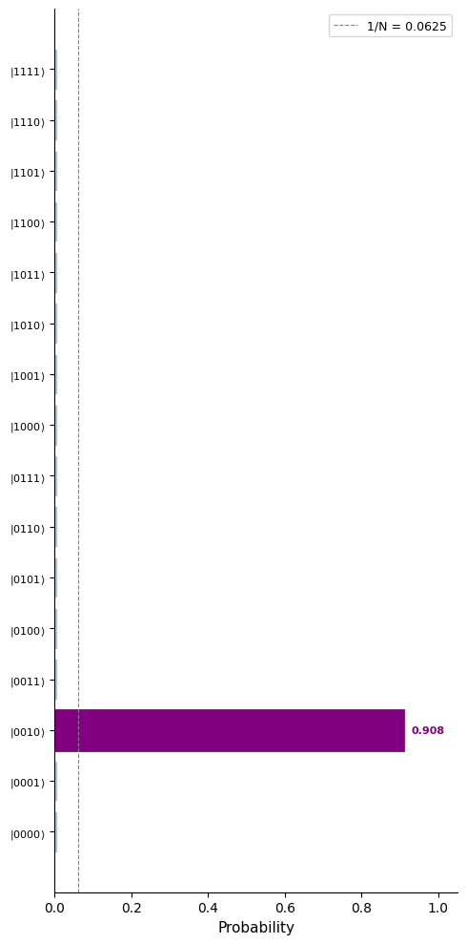

Slide 15
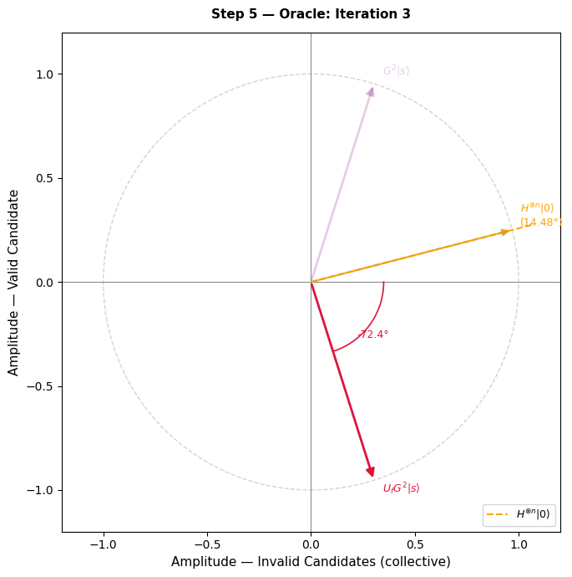
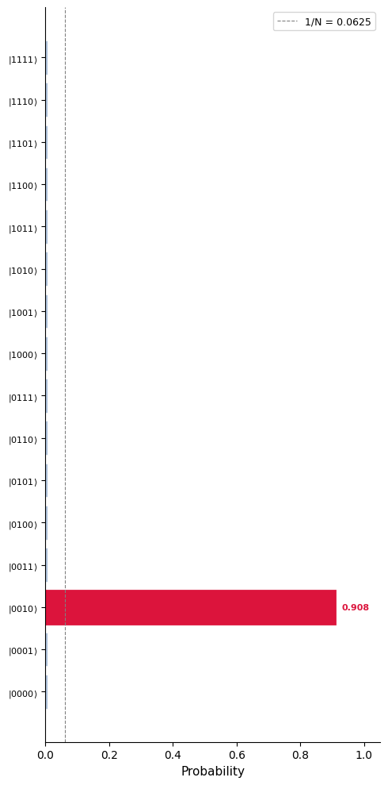

Slide 16
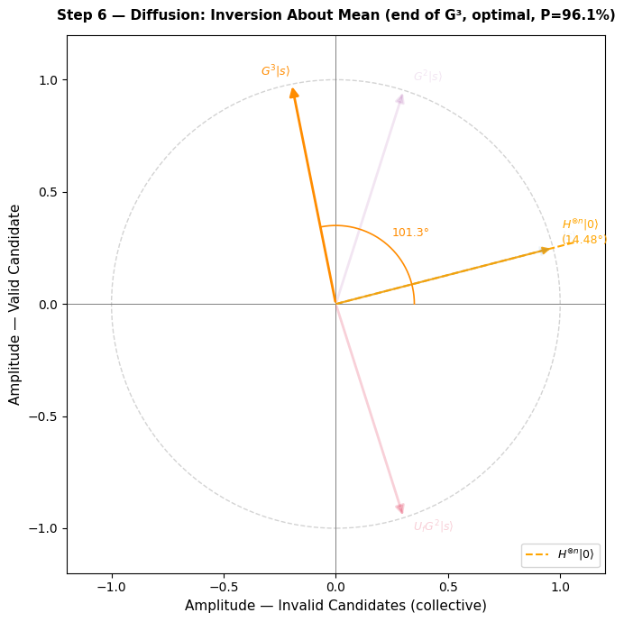
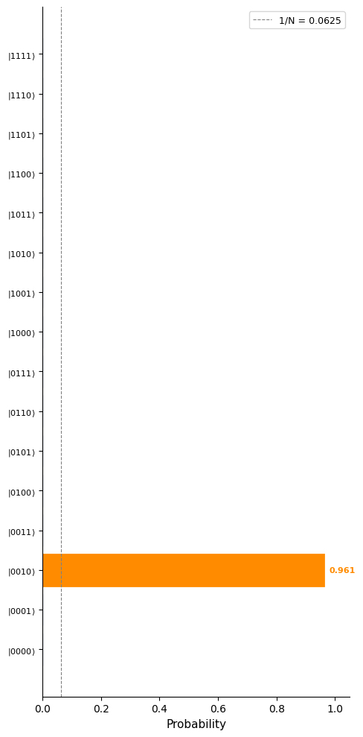

Slide 17
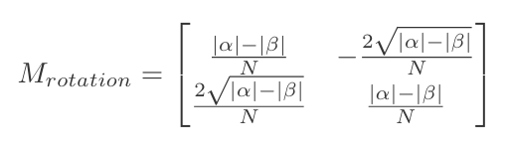
Grover: Picking the Number of Iterations
Uniform mixed state creates angle 𝜽 in solution space
The 2 reflections result in a rotation by 2𝜽 every iteration
Want sin^2((2t+1)𝜽) to be close to 1
(2t-1)𝜽 = π/2
t = π/4𝜽
t = pi/4sqrt(N)
O(sqrt(N))
Notes:
This slide is necessary for showing the time complexity
Actual probability is the square of the amplitude
Absolute val of alpha and beta is # of candidates (basis states)

Slide 18
N=1024
25 iterations

Slide 19
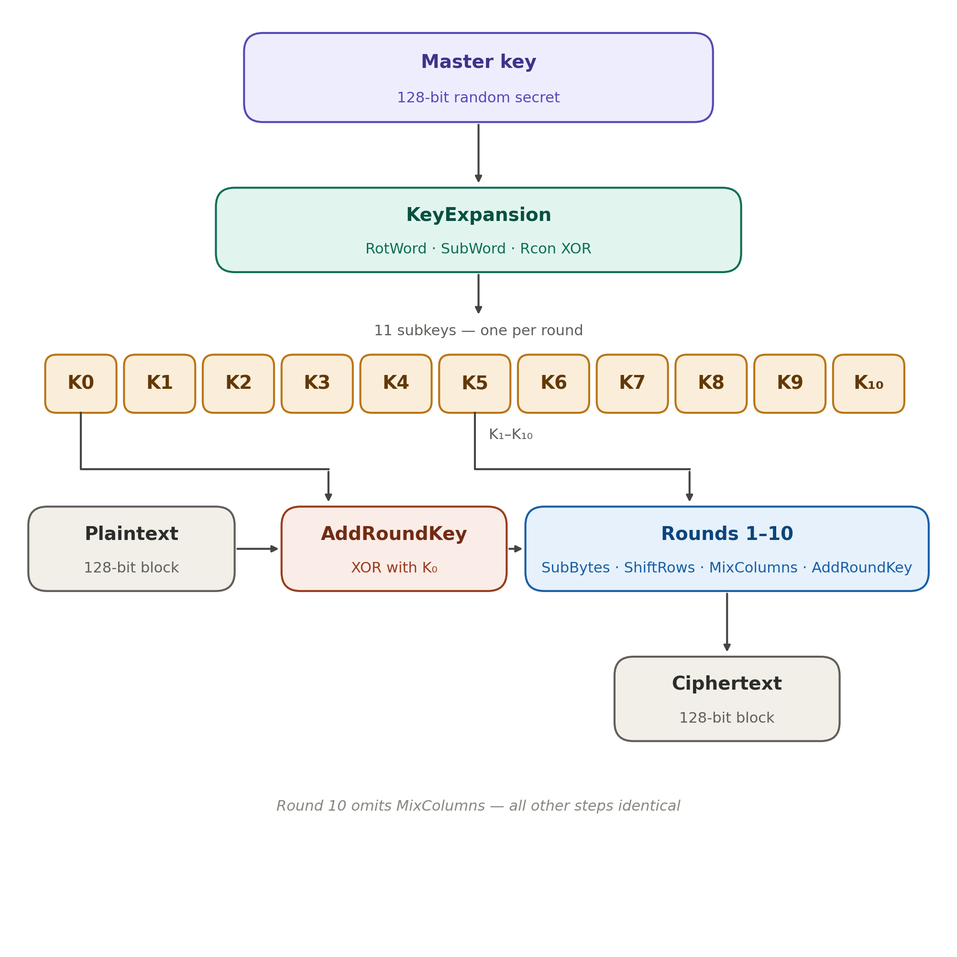
Symmetric Key Encryption and AES-128/192/256
One key encrypts and decrypts data
Algorithm is public, security remains in keeping the key secret
AES(k,p) = c
AES accomplishes this using 4 core functions:
AddRoundKey
MixColumns
ShiftRows
SubBytes
Attack involves having small portion of known plaintext
This is the core of the validation step
Notes:
AES = Advanced Encryption Standard
There is a function that take a key and plaintext to produce a ciphertext, using same func can input the same key and cipher and spits out the plaintext
128/192/256 = more rounds 12 -12 -14
Subkeys are always 128 bits
Attack
Linear and differential cryptanalysis, infer keys based on statistical relationship between plain and cipher
Nist AES standard from 2001: https://nvlpubs.nist.gov/nistpubs/FIPS/NIST.FIPS.197-upd1.pdf

Slide 20
Cost of Quantum Implementation of AES-128
Oracle
Evaluate AES(key,plaintext)
SubWord ≈ 143360 T Gates
AddRoundKey ≈ 128 CNOTs
MixColumns ≈ 277 CNOTs
ShiftRows ≈ relable qubits
SubBytes ≈ 573440 T Gates
Compare result to ciphertext
Multiply Controlled CNOT ≈ 1000 T gates
X2(clear ancilla) x3(plaintext ciphertext pairs) ≈ 5,000,000/iteration
Diffusion (cheap)
128 qubits ≈ 896 T gates
256 qubits ≈ 1792 T gates
｝
1.19 x 2⁸⁶ T Gates
Notes:
Estimates from 2016!!!!
Need more than 1 plaintext ciphertext pair
Why measure in t gate
Fault Tolerant QC hardware frameworks vary a lot
Runtime is not accurate representation of the technology
Cannot actually run something of this scale
T Gates are bottleneck because heavy cost from magic state distillation (not reuseable)
Akin to cost of floating point operations in classical
The expensive stuff
GATE DEPTH
2^80 sequences of parallel operations
“Gate height” for the height of the circuit
Diffusion
Take num qubits X 7 t gates per toffoli gate
Resources for aes grover:
https://link-springer-com.proxy.libraries.rutgers.edu/chapter/10.1007/978-3-319-29360-8_3

Slide 21
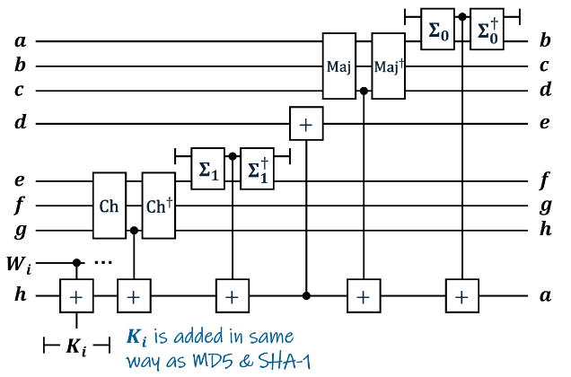
Implications of grovers
O(√N) is the mathematical floor to beat
Also effects hashing
Find x in Hash(x) = y
Limitations
Only quadratic speedup, just increase N to defend (search space increases exponentially)
Complexity of the oracle (increases necessary gates, qubits, compute time)
AES and SHA not designed for quantum
Fig: SHA-2 Quantum Circuit
Notes:
Hashing!!!
SHA = Secure Hash Algorithm
One way functions
Pre-image attack: attempt to find x in Hash(x) = y
Estimates from 2016
2^146
Aes 256 = 2^151
SHA and AES from 2001
Better attack exists having to do with taking advantage of collisions
BHT Brassard Hoyer Tapp
Grover’s hash attack resources:
https://arxiv.org/pdf/2202.10982v1
https://link-springer-com.proxy.libraries.rutgers.edu/chapter/10.1007/978-3-319-69453-5_18
https://ieeexplore-ieee-org.proxy.libraries.rutgers.edu/document/11250564

Slide 22
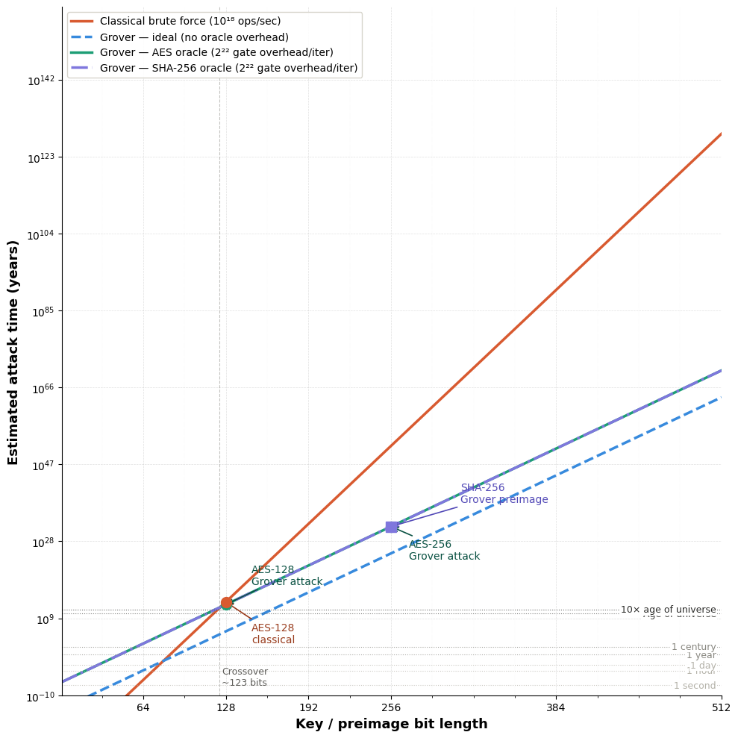
Notes:
10^-10 years is about 3 millisecond
Classical initially lower due to quantum overhead
Quantum running 10^6 logical gates per second VS classical 10^18
Sensitive to hardware assumptions
10^18 is GPU cluster AES cracking in literature

Slide 23
Broad Effects of Quantum Crypto Attacks
Download now decrypt later
Crypto agility
Uncertainty of new findings, pivot quickly
Migration costs
Compute costs
Timeline uncertainty
Quantum tech
Standardization rollouts
NIST 2024 Standards
Key Exchange
Digital Signatures
Notes:
NIST = Nation Institute of Standards and Technology
2024 standards are related to Shor’s vulnra
Nist finalized quantum standards:
https://www.nist.gov/news-events/news/2024/08/nist-releases-first-3-finalized-post-quantum-encryption-standards

